Slide 1
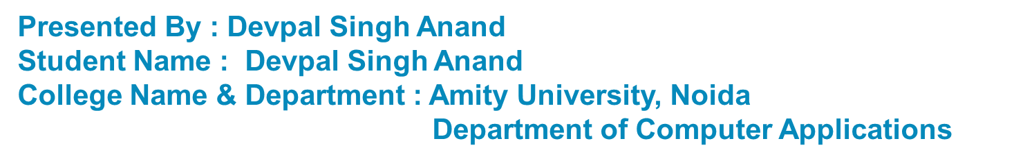
Secure data hiding in images using steganography
CAPSTONE PROJECT

Slide 2
OUTLINE
Problem Statement
Technology used
Wow factor
End users
Result
Conclusion
Git-hub Link
Future scope

Slide 3
Problem Statement
Now-a-days, with increasing need for secure communication; the traditional methods are not often sufficient to protect the sensitive-confidential data from unauthorized access. Here, steganography comes into picture, solving the problem by enhancing security by enabling the user to hide information within images, adding up to a level of security. Thus, the project aims to develop an improved steganography tool with multiple encryption methods for enhanced security and usability.

Slide 4
Technology used
Technology/Library | Purpose/Usage in Project
Python | Core programming language used for steganography.
PyQt6 | GUI framework for encryption and decryption interface.
PIL (Pillow) | Handles image processing and modification.
Crypto (PyCryptodome) | Encryption library for AES, ChaCha20, and RSA.
AES | Encrypts messages securely using AES-GCM mode.
ChaCha20 | A fast and secure stream cipher for encryption.
RSA | Used in AES+ECC for key security.
PKCS1_OAEP | Used in hybrid encryption for AES key security.
Hashlib | Creates cryptographic hashes for password security.
sys | Handles system operations like exiting the application.
QApplication, QWidget, QPushButton, QFileDialog, etc. | GUI elements for user interaction.
QPixmap | Handles image display in the GUI.
Qt | Provides additional GUI functionalities.

Slide 5
Wow factors
1. GUI Implementation – Replaced the command-line interface with a PyQt-based GUI for a user-friendly experience.
2. Multiple Encryption Methods – Added support for XOR, AES, ChaCha20, and AES+ECC encryption, significantly improving security.
3. Hybrid Encryption (AES+ECC) – Introduced AES+ECC encryption for enhanced security, combining symmetric and asymmetric encryption.
4. Separation of Encryption and Decryption – Structured the project into separate encryption and decryption scripts for better maintainability.
5. Support for Text and Files (Planned Enhancement) – Designed the encryption GUI to allow selection between text and file encryption.
6. Password-Based and Key-Based Encryption – Supports both password-based encryption (XOR, AES, ChaCha20) and key-based encryption (AES+ECC), providing more flexibility.

Slide 6
End users
1. General Users (Privacy Advocates)
2. Cryptography Enthusiasts & Researchers
3. Multi-National Corporations (MNCs)
4. Journalists & Whistleblowers
5. Law Enforcement
6. Government Agencies
7. Military & Defense Organizations

Slide 7
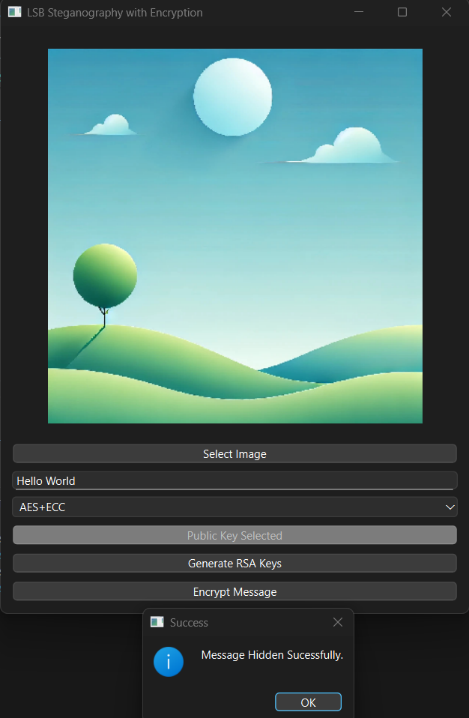
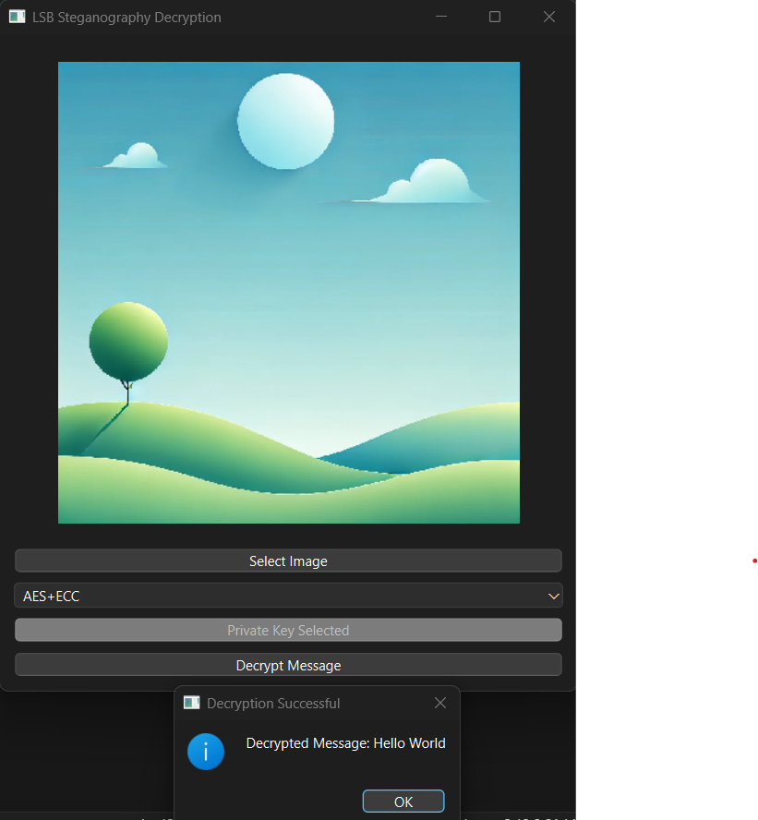
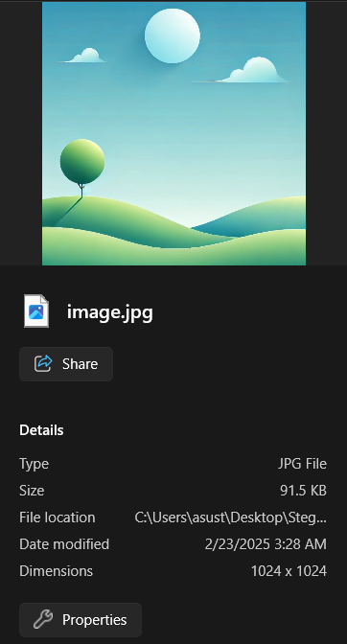
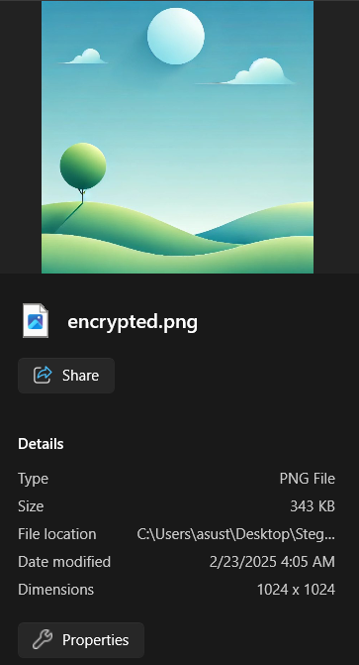
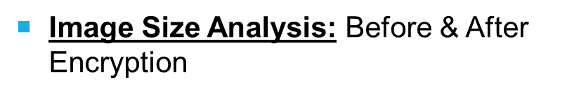
Results

Slide 8
Conclusion
This project demonstrates a robust approach to secure data hiding using steganography, integrating multiple encryption techniques for enhanced protection. By combining an intuitive GUI with advanced cryptographic methods, it ensures both usability and security. The modular design allows flexibility for future improvements, making it a valuable tool for individuals and organizations requiring confidential communication. With planned enhancements like expanded file support and cross-platform compatibility, the project has the potential to evolve into a comprehensive steganographic solution.

Slide 9
GitHub Link
https://github.com/Newbie-amitian/EDUNET-Steganography_Project.git

Slide 10
Future scope(optional)
1. Executable Conversion – Transforming the project into a standalone executable (.exe) for easier distribution and usage.
2. Cross-Platform Compatibility – Modifying the code to ensure seamless operation across various operating systems.
3. Enhanced File Support – Expanding functionality to allow hiding all types of files behind images.
4. Integration of Hashing Algorithms – Implementing various hashing methods for improved integrity and security.
5. Automatic Image Restoration – Enabling automatic reversion of image pixels to their original state after decryption.

Slide 11
THANK YOU

